Slide 1
IT Project
Management
Instructor: Tran Vinh Khiem
March 1st, 2020
S³T
Smart Software System Team

Slide 2

“Being a Project Manager is like being an artist, you have the different colored process streams combining into a work of art.”
– Greg Cimmarrusti
IT Project Management

Slide 3
Learning Objectives
Understand the basic definition of Control system, Version control system, Distributed version control system
Understand and know how to use Git
Understand what is Github and some alternatives.

Slide 4
Resource management
Control System: This basically means that Git is a content tracker. So Git can be used to store content — it is mostly used to store code due to the other features it provides. (Freecodecamp)
Version control system, or VCS, tracks the history of changes as people and teams collaborate on projects together. As the project evolves, teams can run tests, fix bugs, and contribute new code with the confidence that any version can be recovered at any time.
Git is an example of a distributed version control system (DVCS) commonly used for open source and commercial software development. DVCSs allow full access to every file, branch, and iteration of a project, and allows every user access to a full and self-contained history of all changes.
Notes:
What is version control | Atlassian Git Tutorial
An introduction to Git: what it is, and how to use it (freecodecamp.org)
Git Handbook · GitHub Guides
The-Git-Tutorial.ppt - Google Slides
Stack Overflow Developer Survey 2020

Slide 5
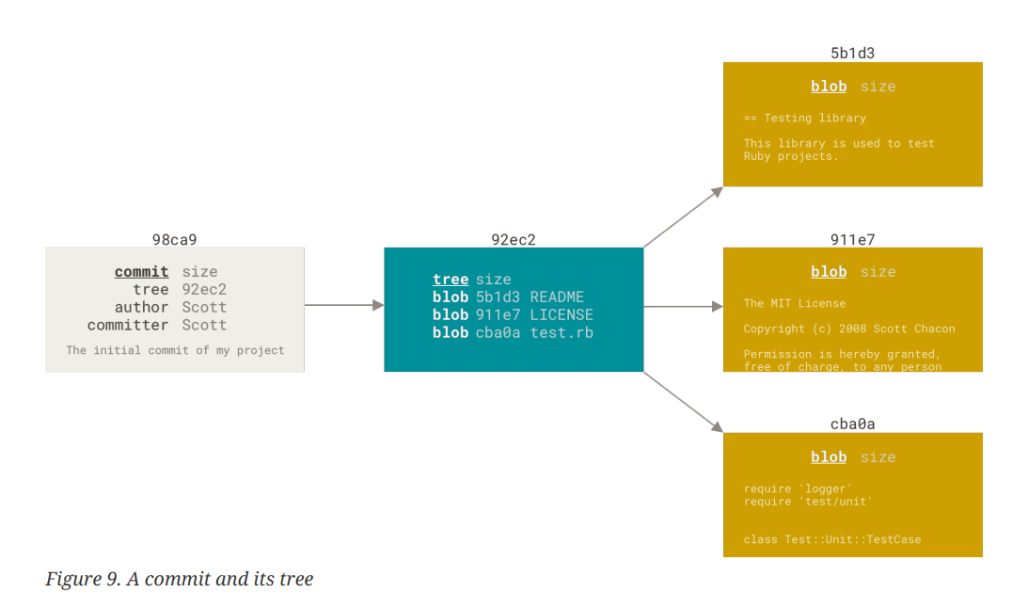
Git branch

Slide 6
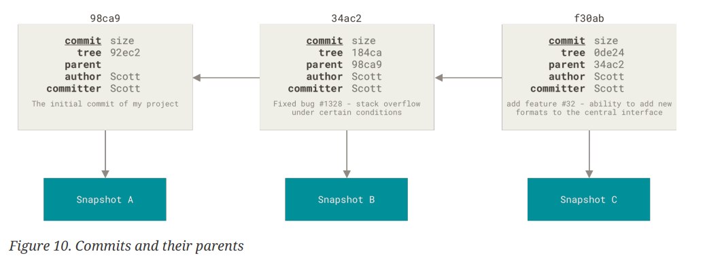
Git branch

Slide 7
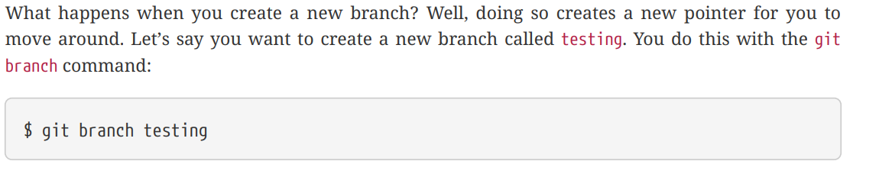
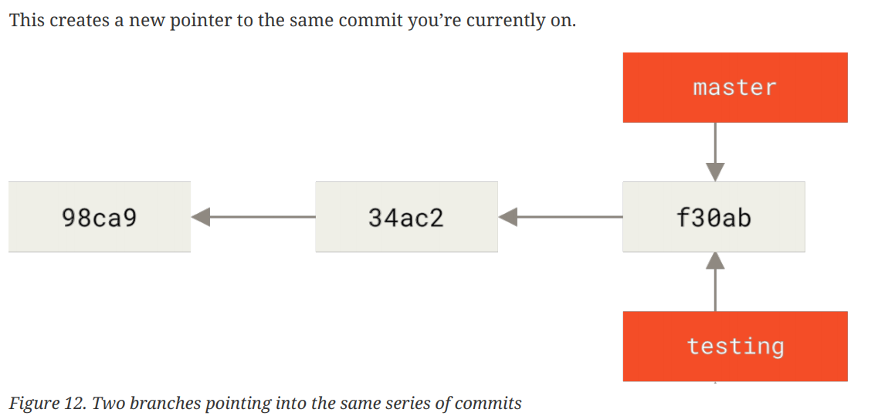
Create new branch

Slide 8
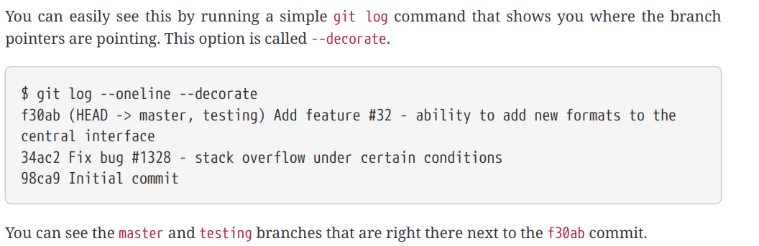
Create new branch

Slide 9
Create new branch

Slide 10
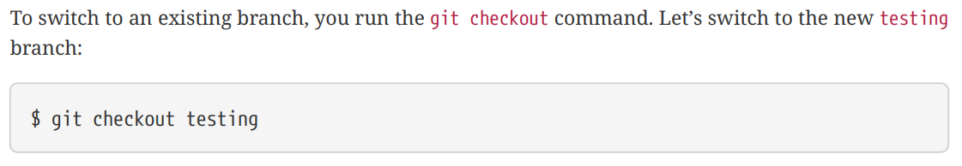
Switch branches

Slide 11
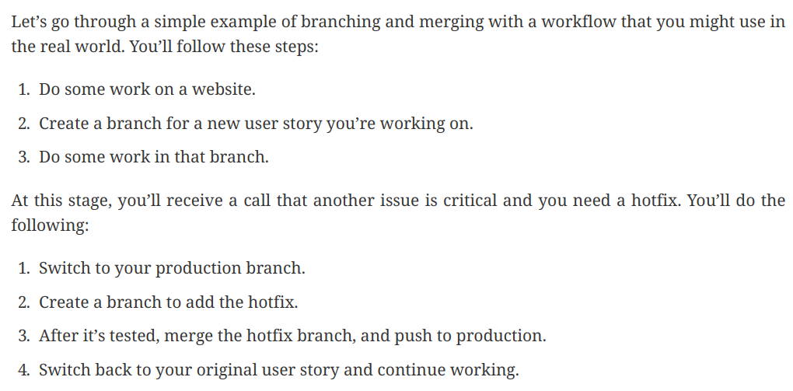
Basic Branching and Merging

Slide 12
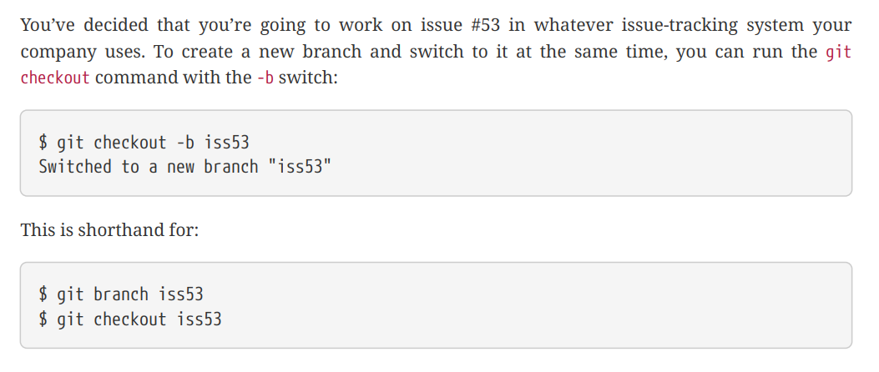
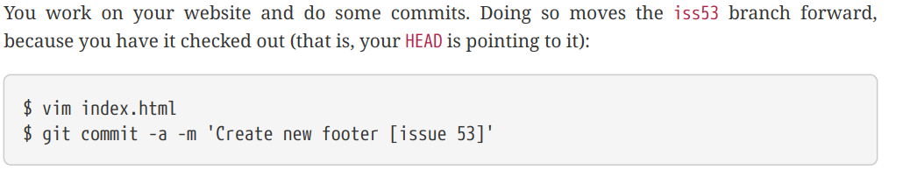
Basic Branching

Slide 13
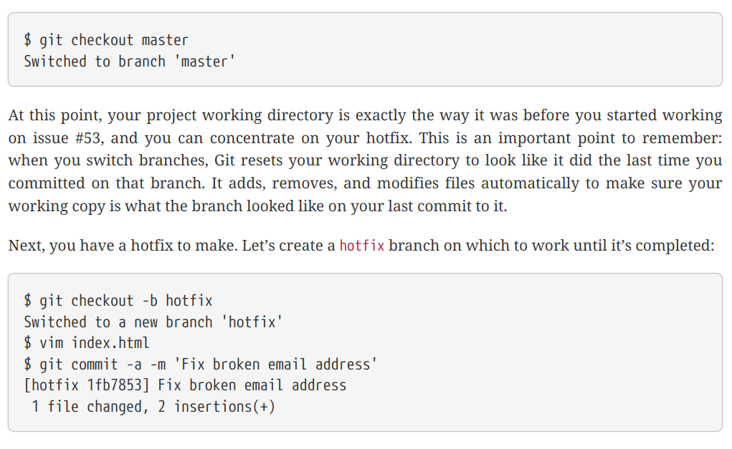
Basic Branching

Slide 14
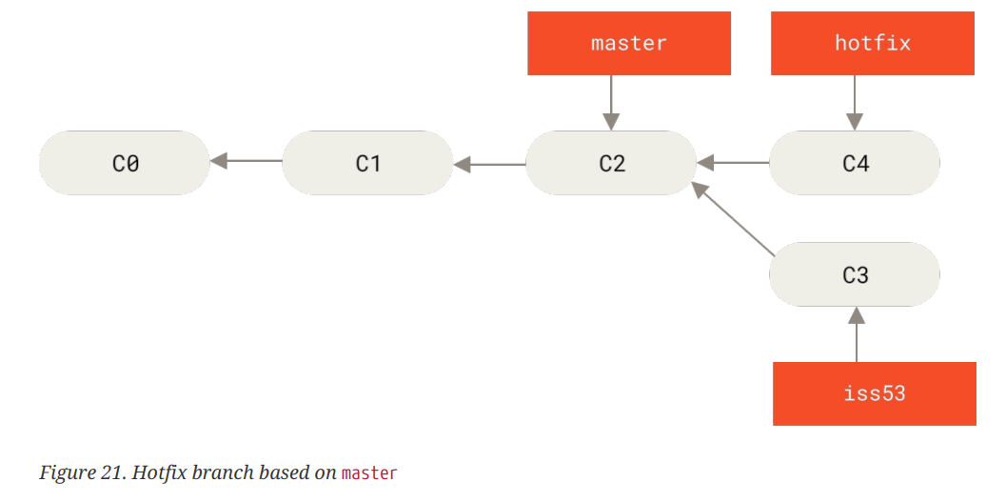
Basic Branching

Slide 15
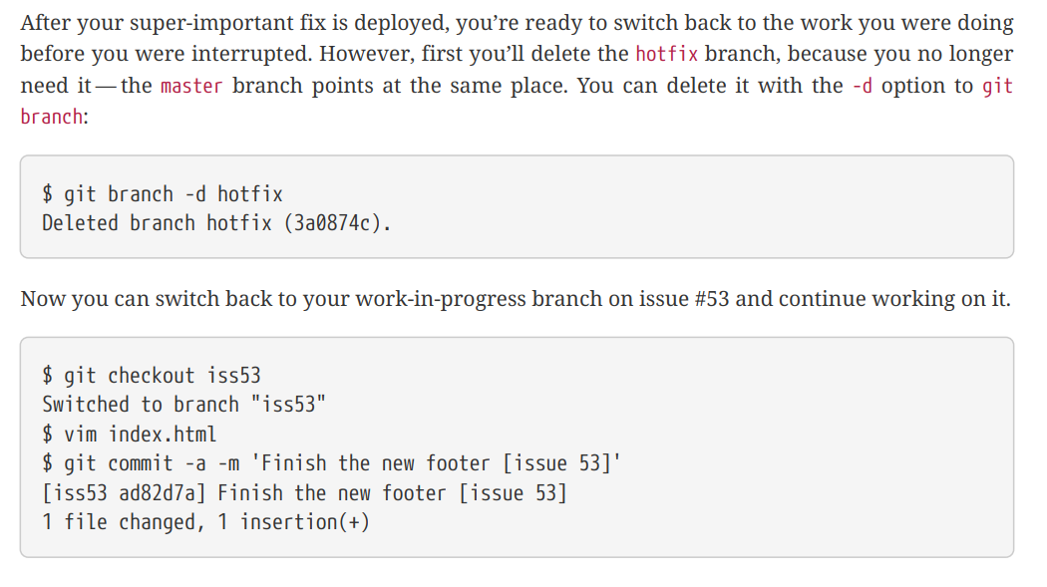
Basic Branching

Slide 16
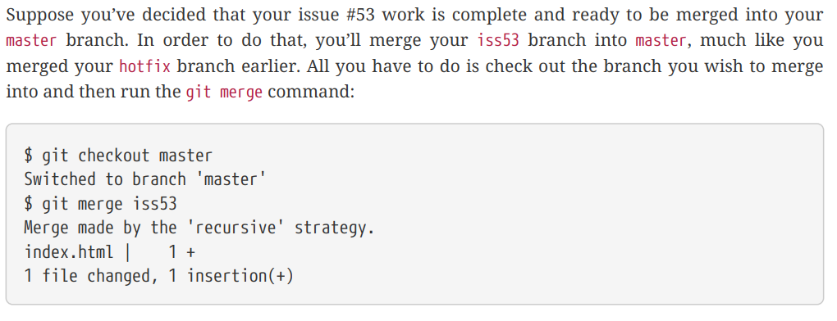
Basic Merging

Slide 17
Basic Merging - Quick guide
Git merge will combine multiple sequences of commits into one unified history.
Git merge is used to combine two branches.

Slide 18
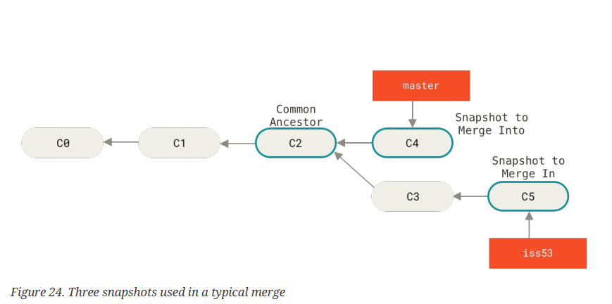
Basic Merging

Slide 19
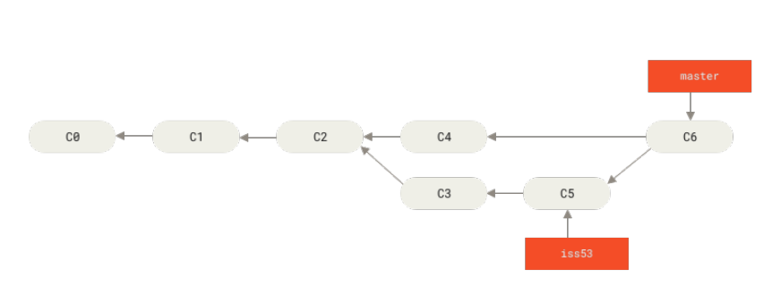
Basic Merging

Slide 20
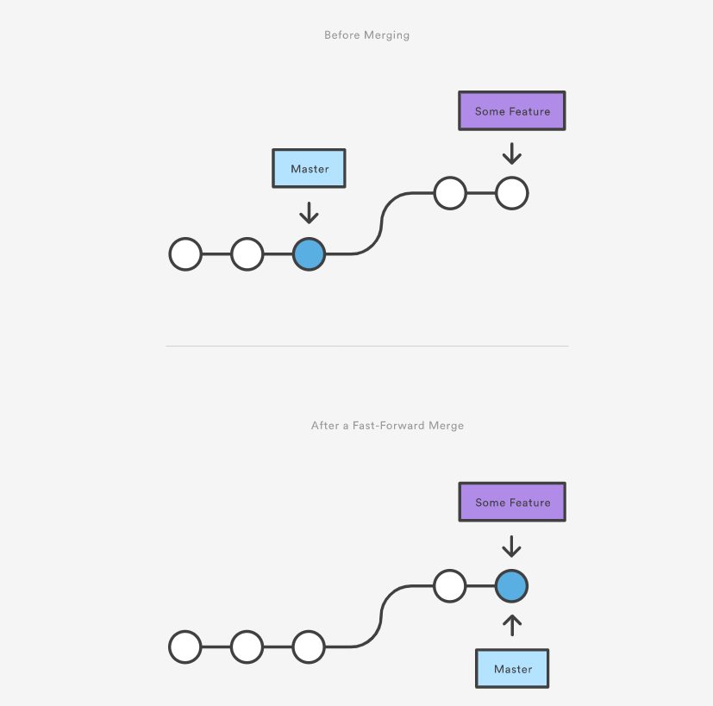
Basic Merge – Fast Forward Merge

Slide 21
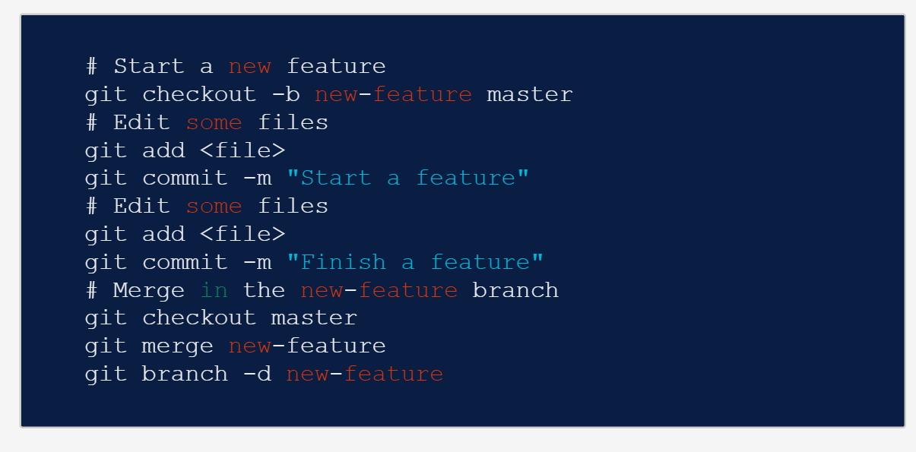
Basic Merge – Fast Forward Merge

Slide 22
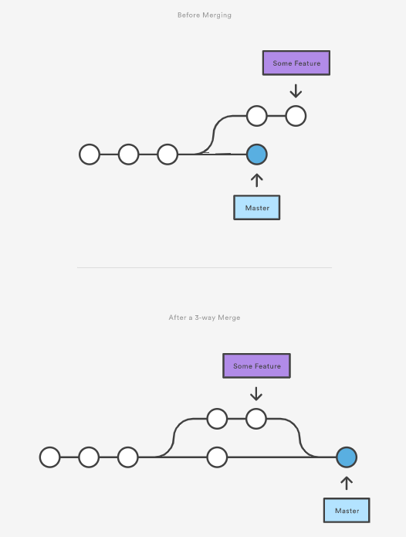
Basic Merge – 3 way merge

Slide 23
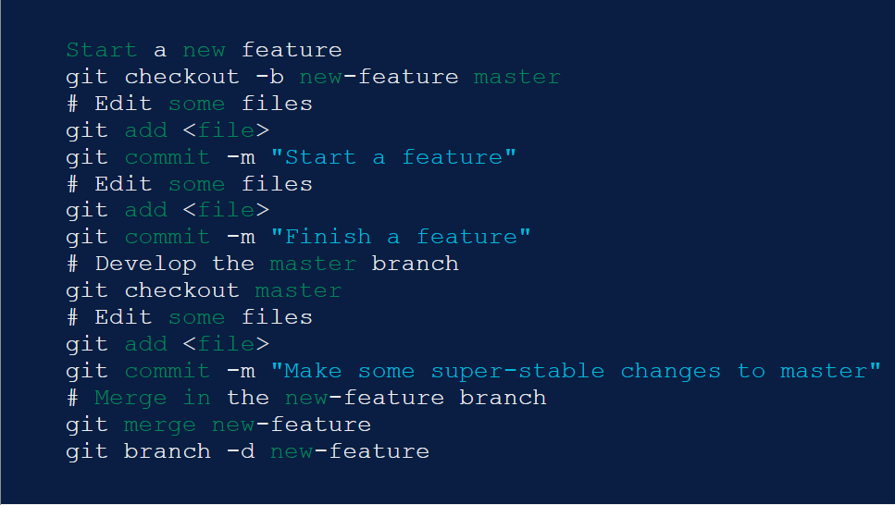
Basic Merge – 3 way merge

Slide 24
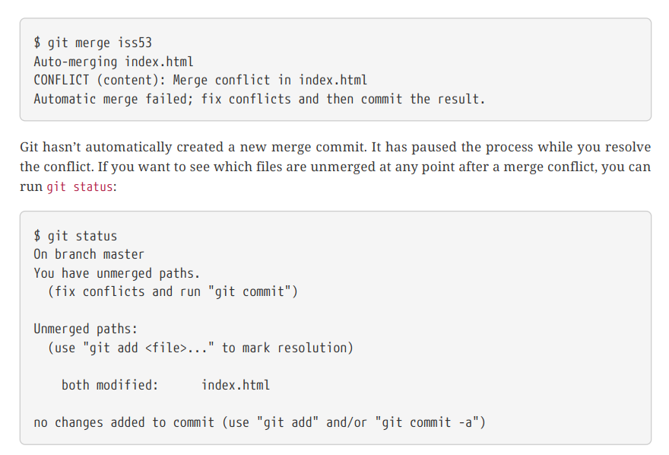
Basic Merge Conflicts

Slide 25
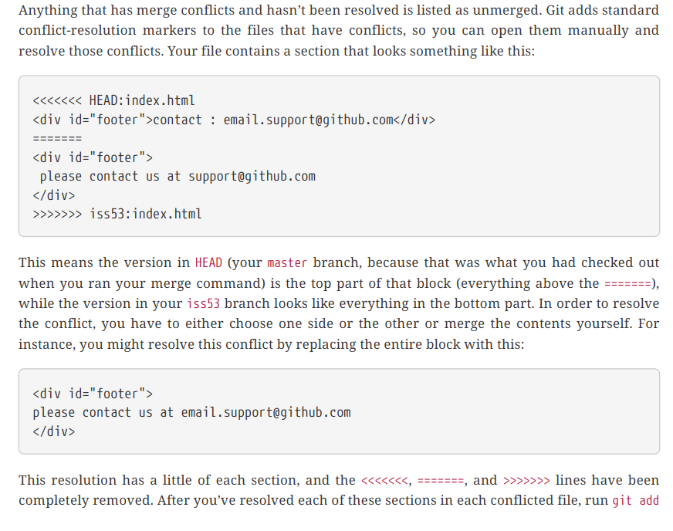
Basic Merge Conflicts

Slide 26
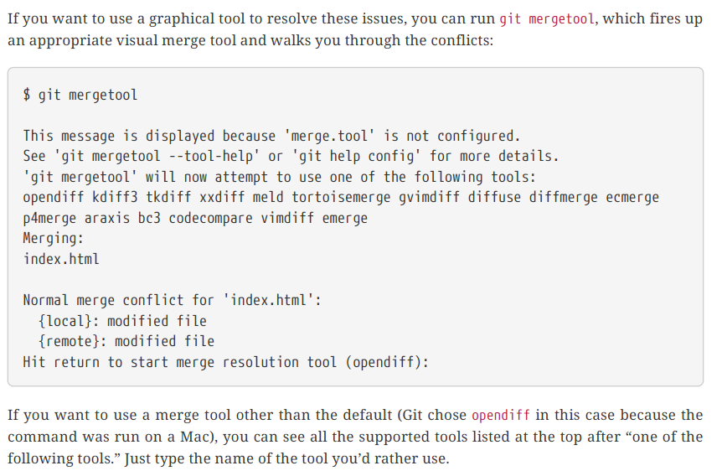
Basic Merge Conflicts

Slide 27
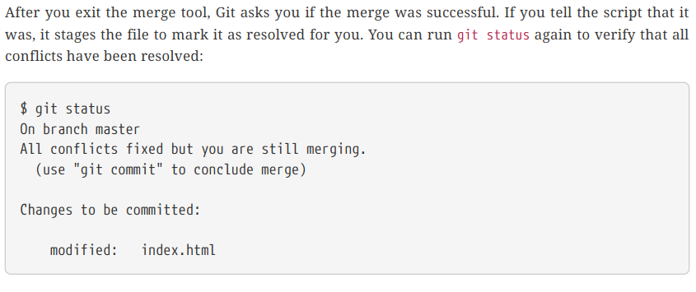
Basic Merge Conflicts

Slide 28
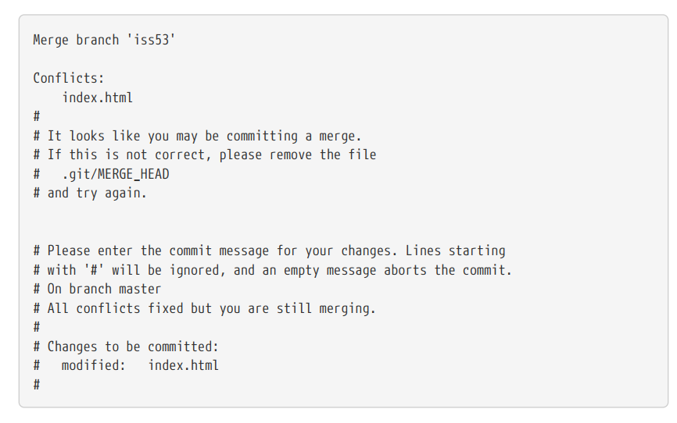
Basic Merge Conflicts

Slide 29
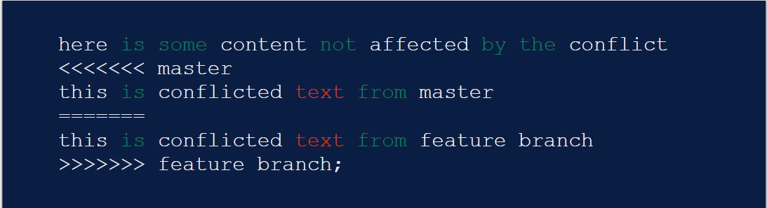
Basic Merge Conflicts – Read more

Slide 30
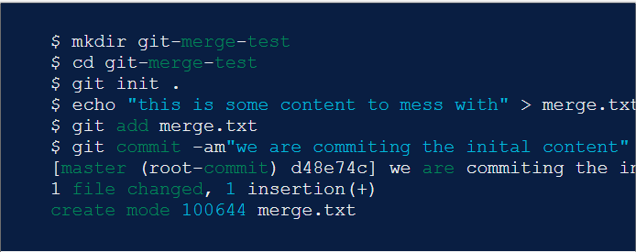
Basic Merge Conflicts – Exercise

Slide 31
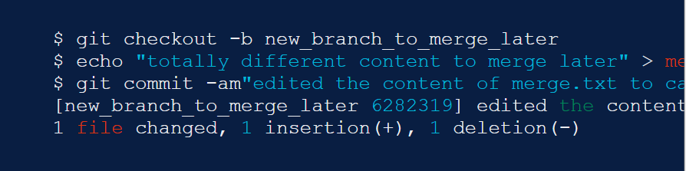
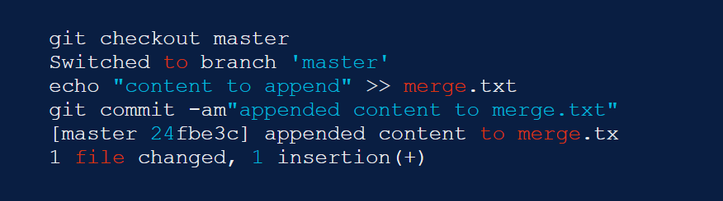
Basic Merge Conflicts – Exercise

Slide 32
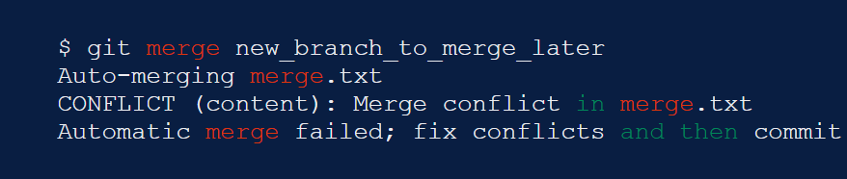
Basic Merge Conflicts – Exercise

Slide 33
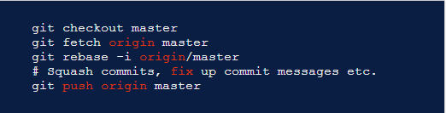
Git push– Exercise

Slide 34


Git pull rebase instead of merge – Exercise

Slide 35

Github – Create repo
Access to github.com, create new repo.
Access to github.com, create new repo.

Slide 36
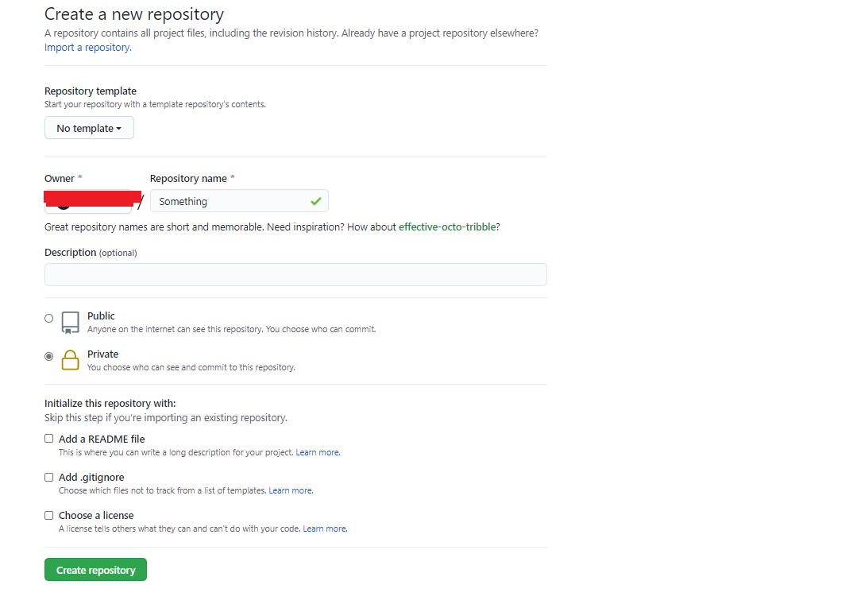
Github – Create repo

Slide 37
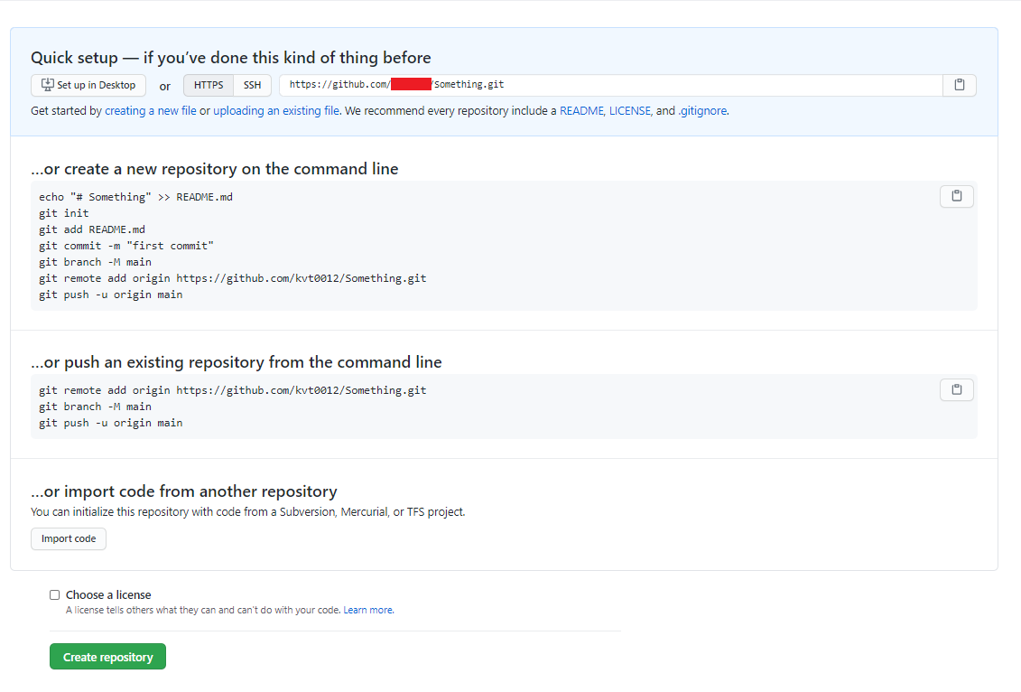
Github – Create repo
Do all 3 ways below.

Slide 38
Github – SSH
Follow and do all guidance on this link: Connecting to GitHub with SSH - GitHub Docs

Slide 39
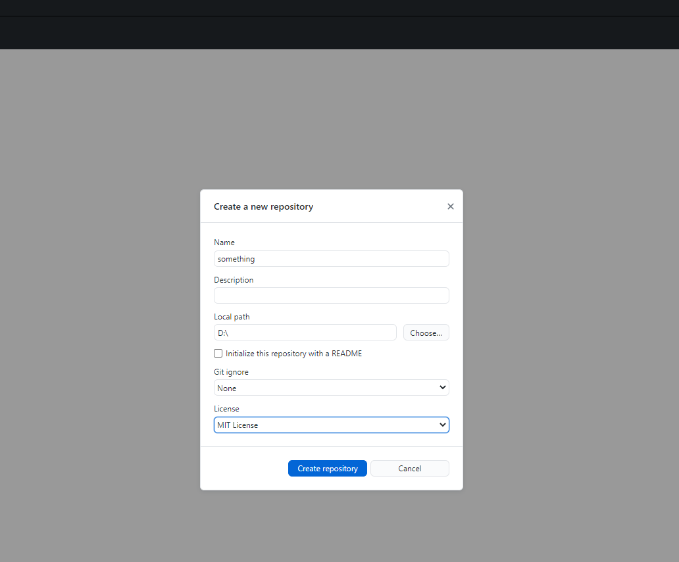
Github – Create repo – second way
Download github desktop → Click on File → New → Fill information as below.

Slide 40
Gitlab
Download Fork→ Do same thing as above from github

Slide 41
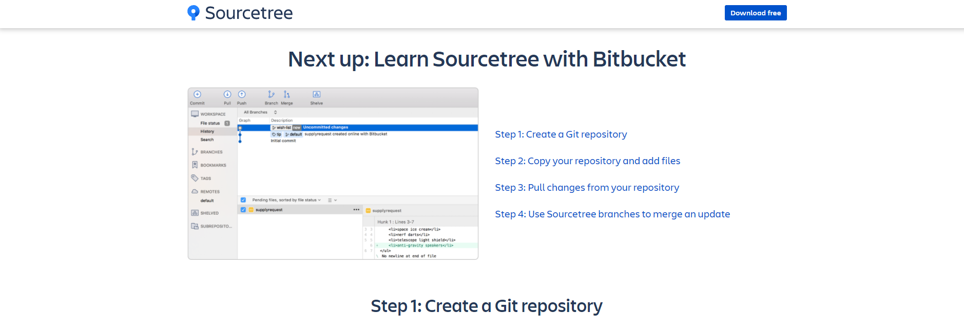
Sourcetree
Download Sourcetree→ Do same thing as above from github

Slide 42
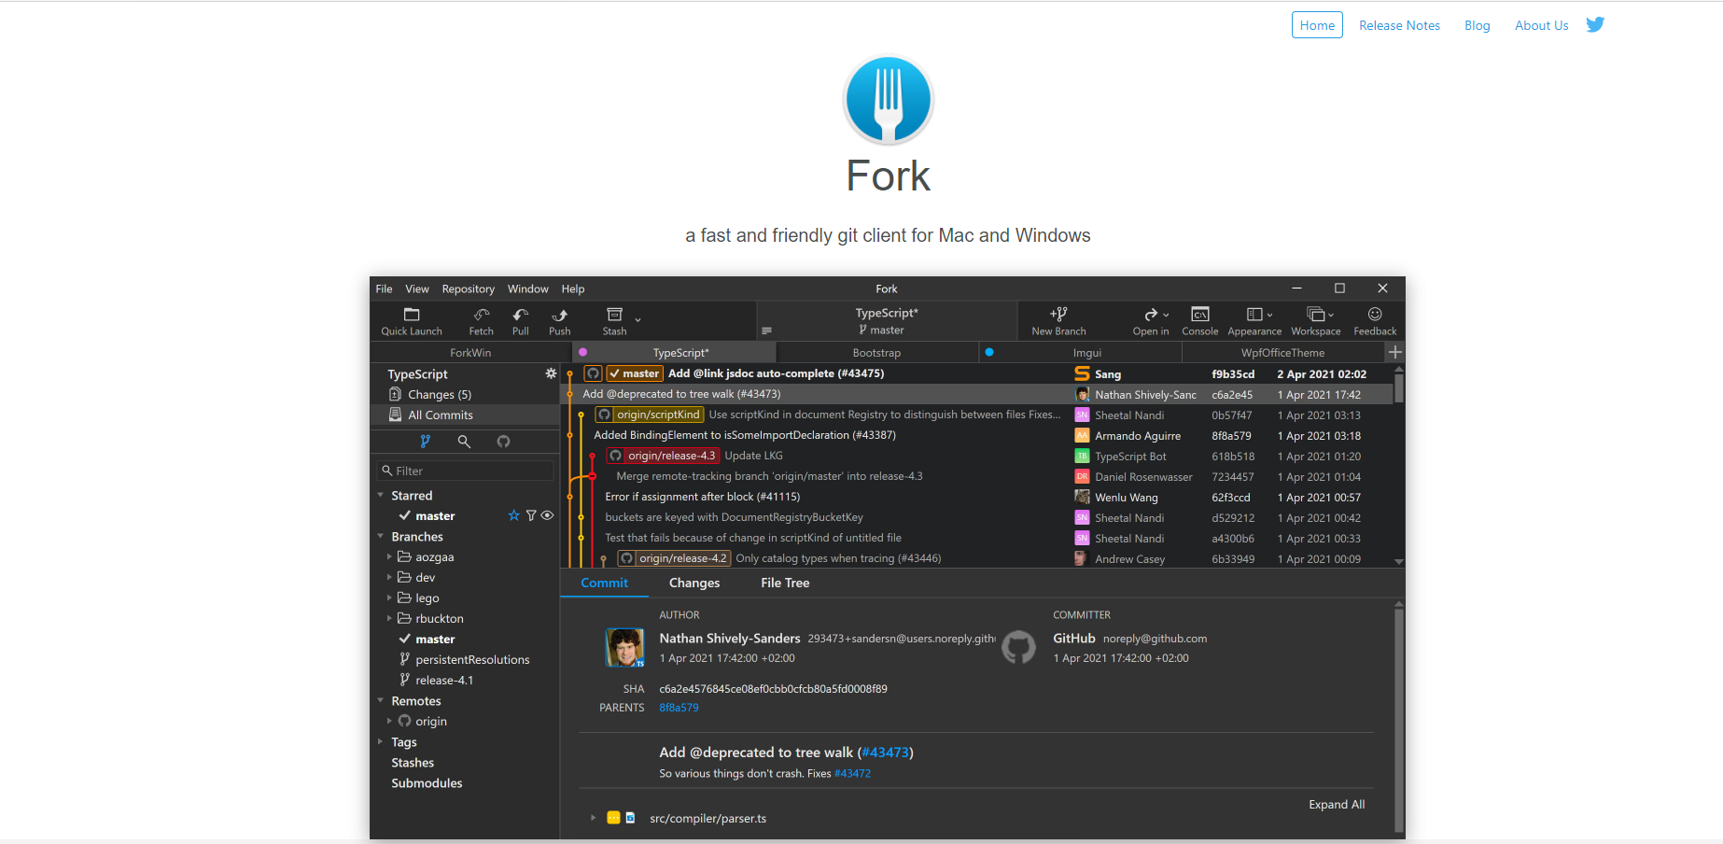
Fork
Download Fork→ Do same thing as above from github

Slide 43
Q & A
Thank you for attention
“Coming together is a beginning;
Keeping together is progress;
Working together is success.”
- HENRY FORD

